Slide 1
Jewellery Shopping Website
Presented By :
Hari Om Singh – 235/PCD/016
Nishant Rajput – 235/PCD/029
Nitin Bahuguna – 235/pcd/030
Shobhit Yadav – 235/PCD/037
Presented to: Dr. Shiromani BalMukund Rahi

Slide 2
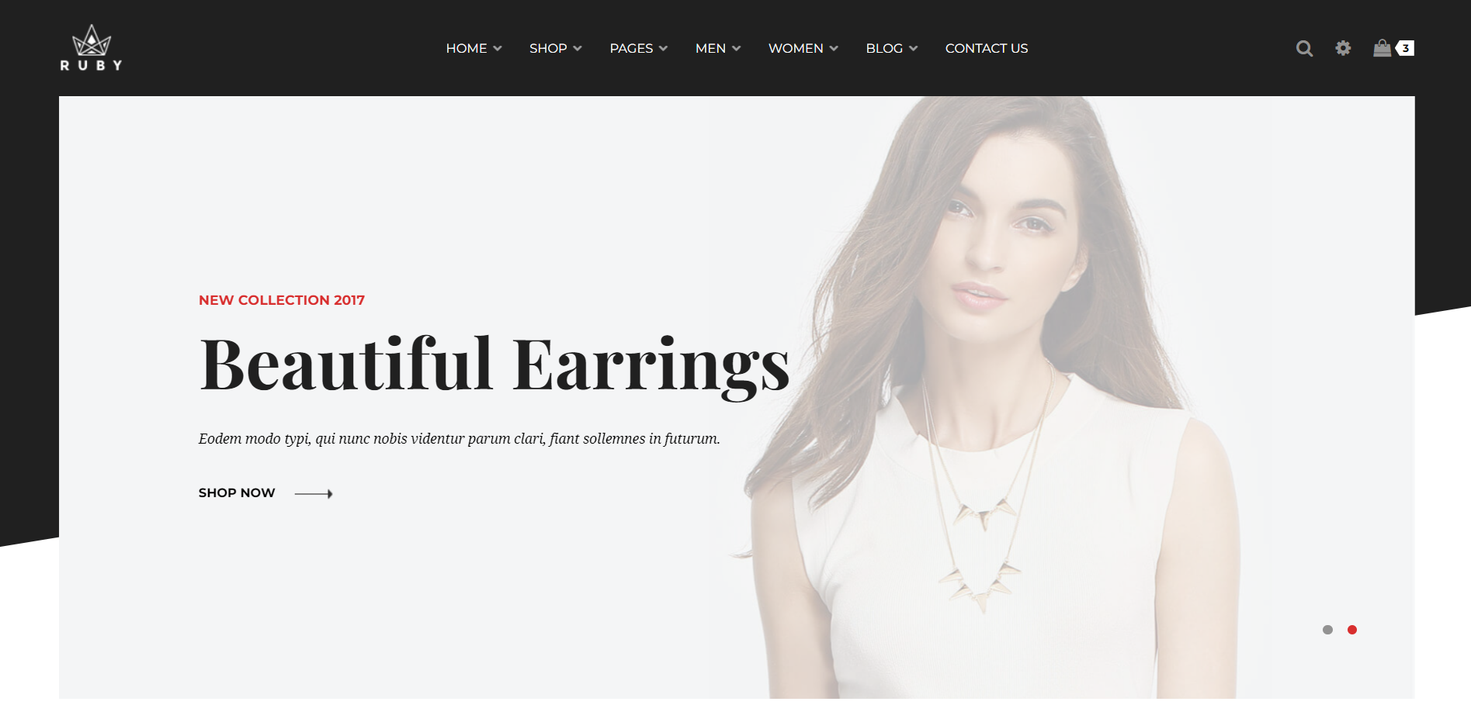
Introduction
Our jewellery shopping website provides an online platform for purchasing a wide range of jewellery products, including rings, necklaces, bracelets, and earrings. With user-friendly navigation, secure payment gateways, and customer support, the site is designed to offer an exceptional shopping experience.

Slide 3
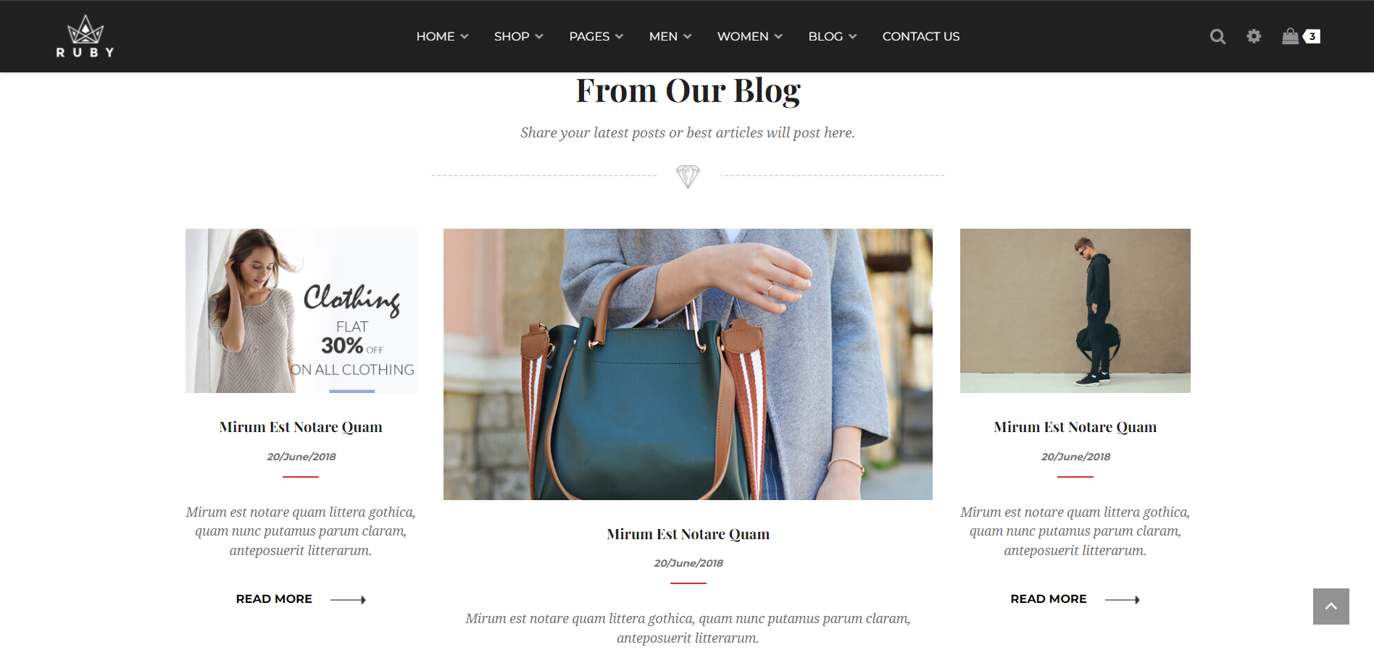
User Experience
The website provides a seamless and intuitive user experience. Customers can easily browse products, apply filters, and add items to their shopping cart. The checkout process is straightforward, with multiple payment options and quick customer support in case of any issues.

Slide 4
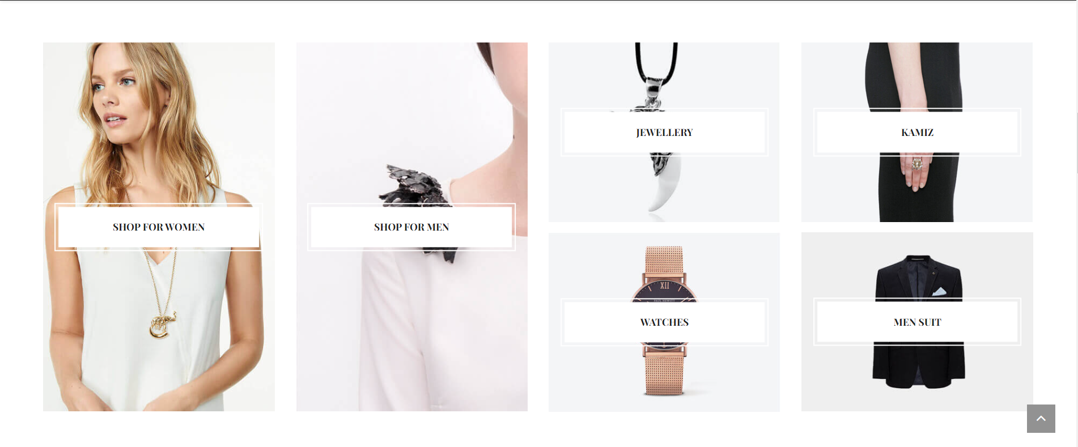

Slide 5
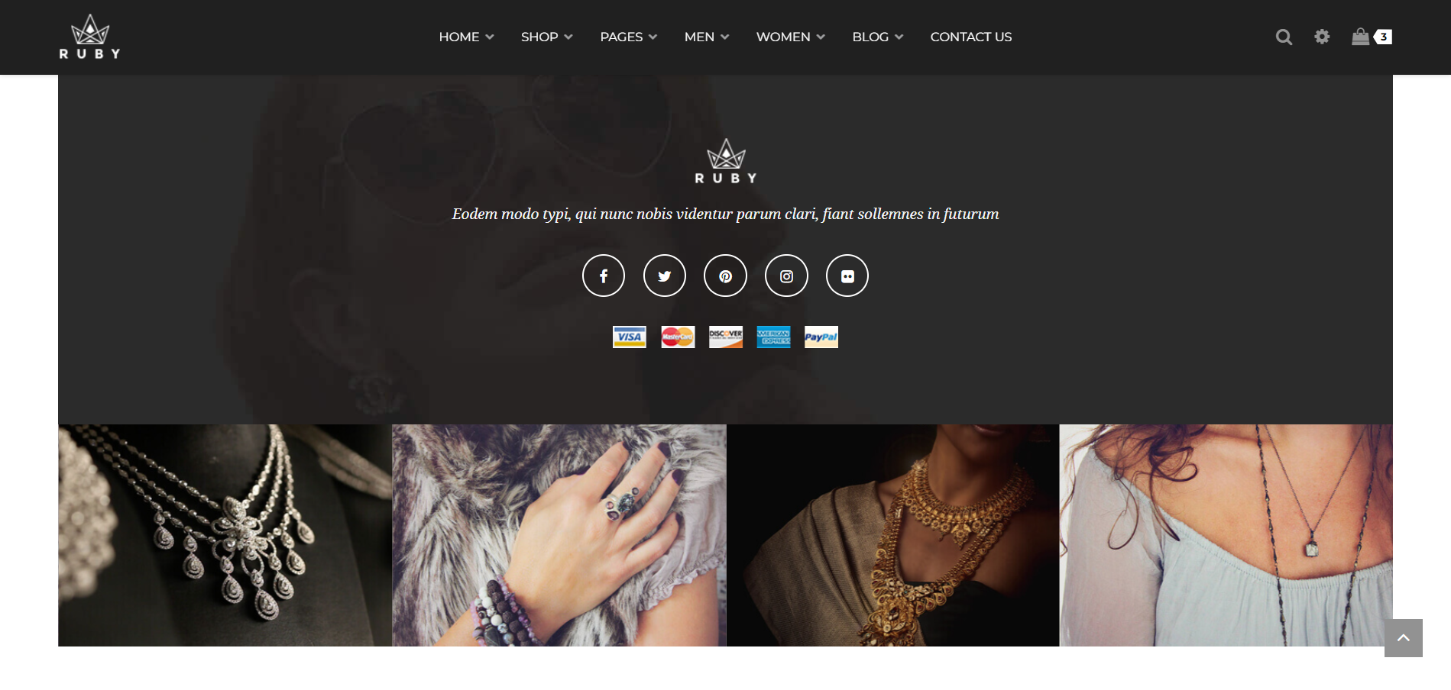

Slide 7
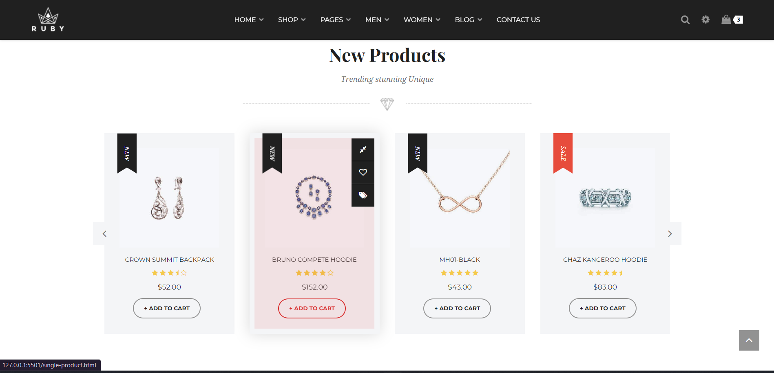

Slide 8
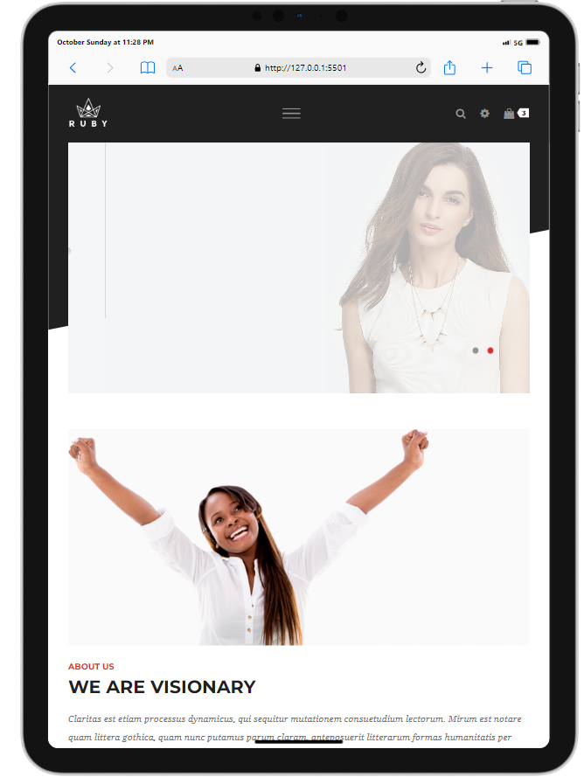
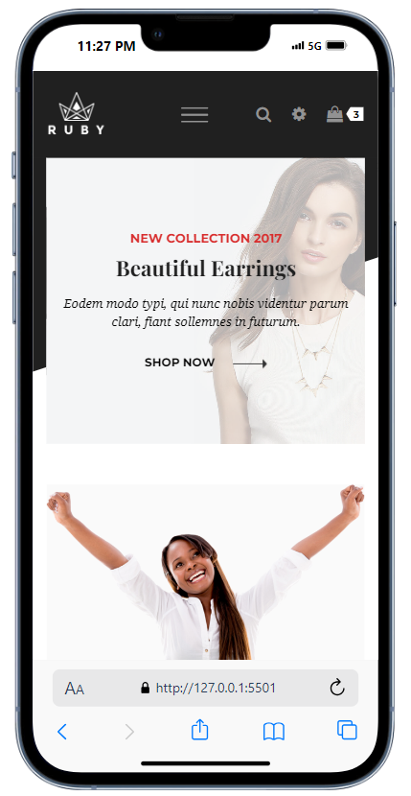
Responsiveness

Slide 9
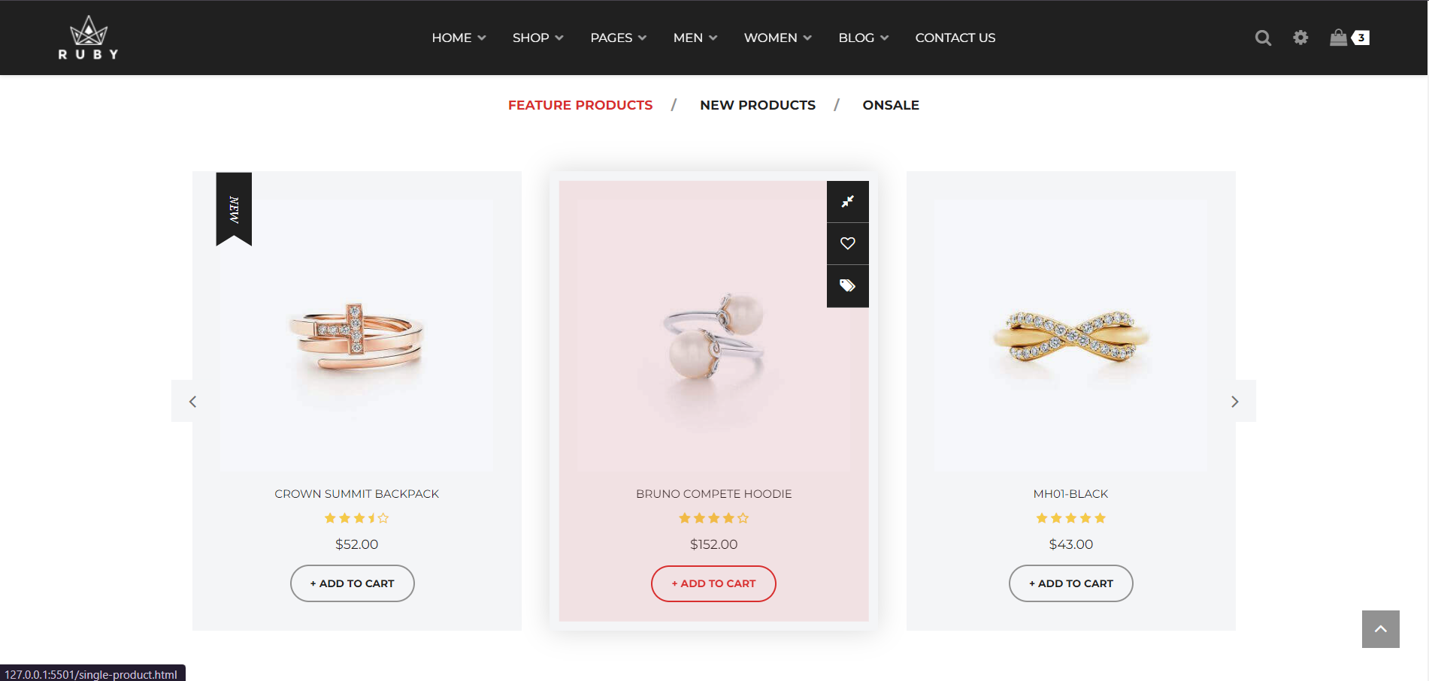
Purpose
The purpose of the jewellery shopping website is to offer a convenient, reliable, and comprehensive platform for customers to browse and purchase fine jewellery from the comfort of their home, while ensuring security and customer satisfaction.

Slide 10
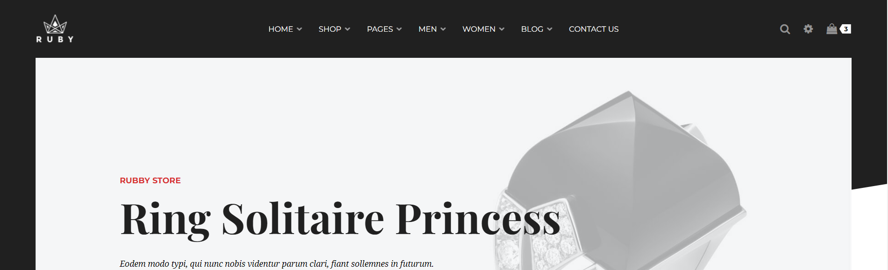
Key Features
Wide range of jewellery products
Secure payment options\n- 24/7 customer service
Easy navigation and filtering
Exclusive deals and offers for members

Slide 11
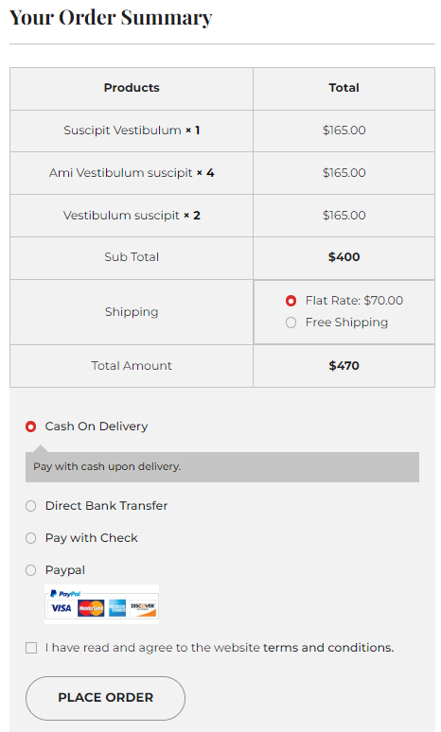
Security and Payment Options
- SSL encryption for secure transactions\n- Multiple payment methods (Credit/Debit Card, PayPal, UPI)\n- Secure checkout process to protect customer data

Slide 12
Jewellery Categories
The website offers a variety of categories to meet diverse customer needs
Rings\n- Necklaces
Bracelets
Earrings
Customized jewellery

Slide 13
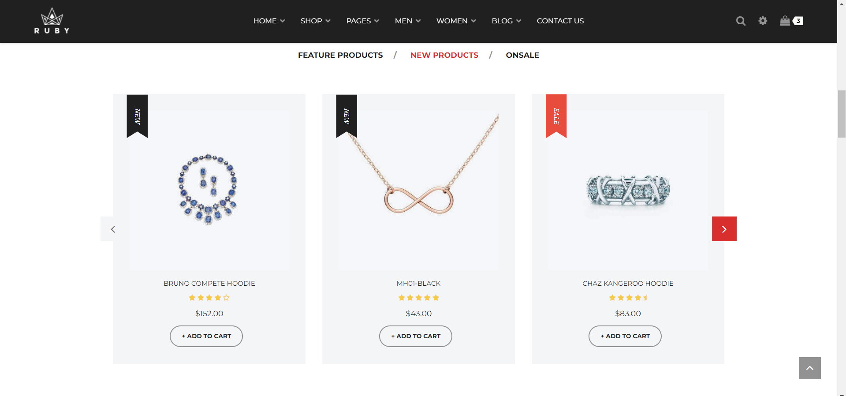

Slide 14
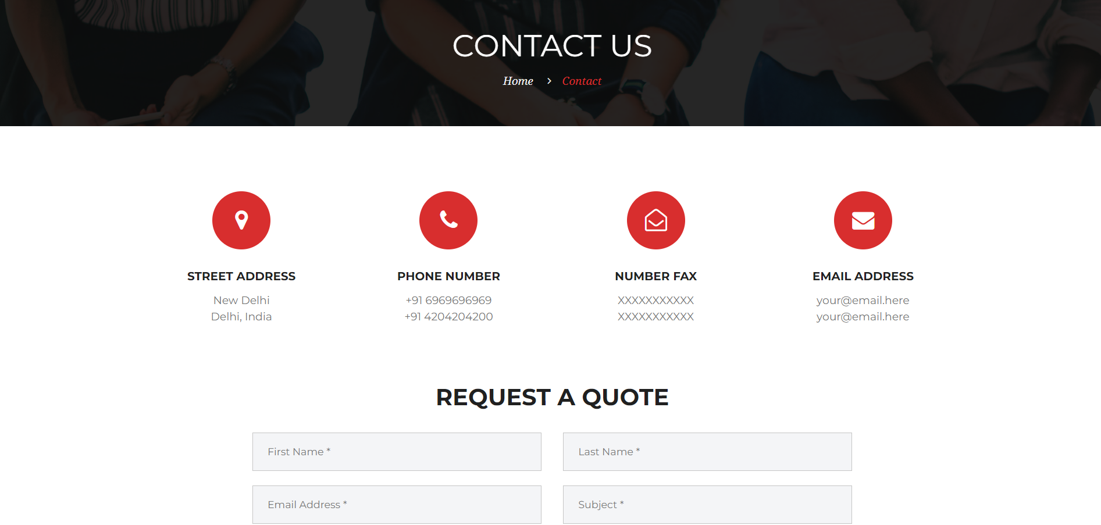
Contact Information

Slide 15
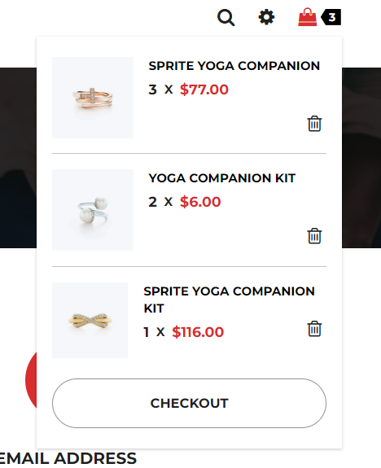
Future Expansion
As we continue to grow, we plan to expand into international markets, add more categories like men's jewellery, and introduce virtual try-on technology to enhance the shopping experience.

Slide 16
Conclusion
The jewellery shopping website we've developed combines elegance, functionality, and security to deliver an outstanding shopping experience. By offering a vast selection of high-quality products, intuitive navigation, and personalized customer service, the platform caters to a diverse range of users. With its focus on convenience, user satisfaction, and digital security, this website is poised to become a trusted and popular choice for jewellery enthusiasts.
We believe this project has significant potential to grow and succeed in the competitive e-commerce market, attracting a broad audience and ensuring long-term success.

Slide 17
Thank You
Thank you for your time and attention. We hope you enjoyed learning about our jewellery shopping website.
Presented By :
Hari Om Singh – 235/PCD/016
Nishant Rajput – 235/PCD/029
Nitin Bahuguna – 235/PCD/030
Shobhit Yadav – 235/PCD/037

